Slide 1
House price prediction
NYCDSA
Machine Learning Project
Jungu Kang

Slide 2
Background
Recent technology allows people to explore almost everywhere online.
It’s not different when it comes to real estate
However, pictures and some basic information won’t be enough for the buyers to decide
The purpose of this project was to study the house features and find out what would affect the sale price
This house price dataset from Kaggle contains 79 explanatory variables for houses in Ames, Iowa, and one target variable as the sale price with 2930 observations

Slide 3
Dataset analysis
Type | Number | Example
Categorical | 23 | Street, Neighborhood
Ordinal | 23 | Quality
Discrete | 14 | Number of rooms
Continuous | 20 | Square feet

Slide 4
Feature engineering and selection
Prior to finding a model, the target variable, sale price, was studied, and then feature engineering was performed for other variables
The sale price was right-skewed, so, the logarithm transformation was applied and the result for both was compared at the model selection

Slide 5
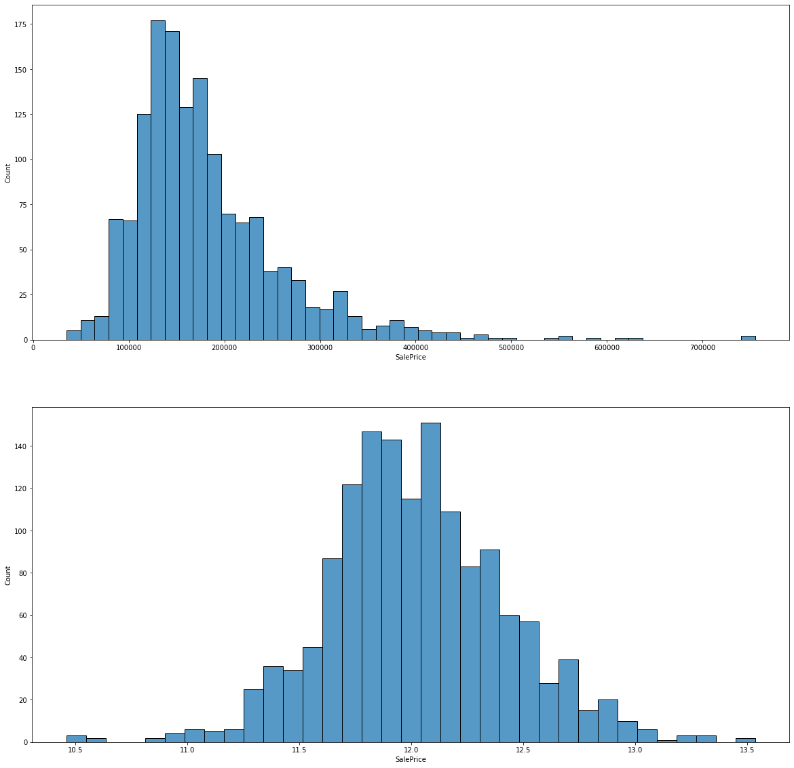
Original
Vs
Log Transformed

Slide 6
Feature engineering and selection
All categorical and ordinal variables were dummified
All discrete variables were checked to see which one it is closer to between categorical and continuous variable
Since some of the continuous variables included "none" in the values, they would cause inaccuracy in the final model without any appropriate preprocessing
For example, the garage year built has none but the model would think the ‘none’ as it was built in 0(zero) instead of none-meaning no garage

Slide 7
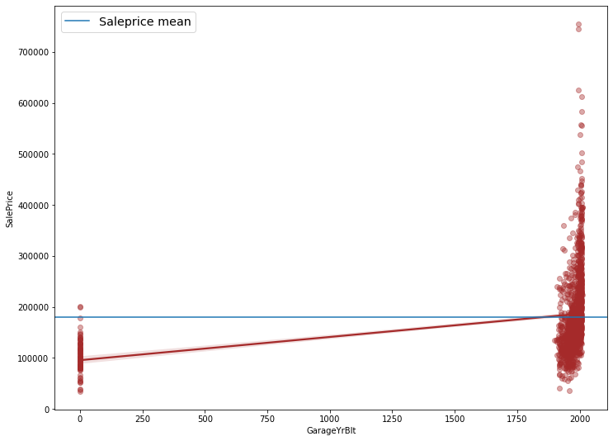

Slide 8
Feature engineering and selection
The correlation between the sale price and other variables was observed
Then, the correlation within a variable to the rest was researched to see the multicollinearity and to remove it if there is any
Total 44 variables were chosen for prediction

Slide 9
Regression model
Linear, Lasso, Ridge, ElasticNet, RandomForestRegressor, SVR, KernelRidge, and XGBoost were used to find out the best model
Grid search to obtain the best estimator for each model
R2 score and RMSE(Root Mean Square Error) were used to evaluate the models’ performance
Feature importance was also studied for the final model

Slide 10
Result
Model | R2(original) | R2(transformed) | RMSE(transformed)
LinearRegression | 0.812 | 0.835 | 0.158
Lasso | 0.811 | 0.834 | 0.158
Ridge | 0.817 | 0.837 | 0.157
ElasticNet | 0.817 | 0.836 | 0.157
SVR | 0.676 | 0.820 | 0.158
KernelRidge | 0.810 | 0.834 | 0.198
RandomForestRegressor | 0.844 | 0.845 | 0.155
XGBoost | 0.855 | 0.856 | 0.146

Slide 11
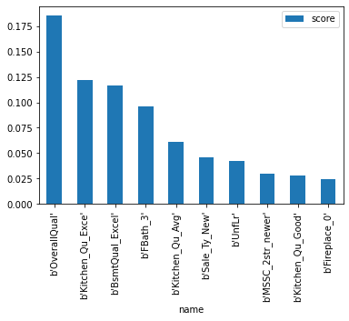
Feature importances

Slide 12
result
The most important feature is the overall quality
If you are a seller, you may want to maintain the quality of the kitchen and basement in good condition for a higher sale price.
The other features such as the number of full bathroom and fireplace, may not be easy to improve unless you do remodeling.
RSME for the test dataset was 0.1362 in Kaggle
Notes:
What features affect the house price?

Slide 13
Future study
Different point of view for feature engineering and selection may result in a more accurate prediction
Study in different cities could provide information whether the important features are the same. This can support the result of this project

Slide 14
Questions?

